Slide 2
accordant | achieve | adamant | ancient | applicable
according | advice | adorable | anti-clockwise | artificial
accountant | advise | aggressive | anti-virus | assistant
Phonemes
Let’s look at each of the words and break them into phonemes (units of sound).
The dots show 1 sound represented by 1 letter ( 1 grapheme).
The dashes show 1 sound represented by 2 letters (digraph).
a cc or d a n t

Slide 3

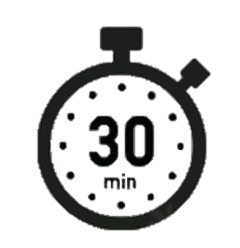
Spell it out
attached | bargain | bruise | cemetery | communicate
average | bought | committee | changeable | competition
awkward | brought | cautious | circumstantial | conceive
Day 1

Slide 4
Spell it out
conceived | conscientious | curiosity | deceive | develop
confidential | coordinates | deceit | deceived | device
contentious | cough | deceitful | desperate | devise
Day 1

Slide 5
Spell it out
doubt | expectant | fought | gnat | hesitant
enough | fictitious | gnarl | gnaw | impartial
essential | forcible | gnarled | gracious | incredible
Day 1

