Slide 1
iPads and e-learning
8th October

Slide 2
Aims
To have a look at some of the key apps that will help all children make progress in all lessons.
Share any good practise.
Ask any questions.

Slide 3
Curriculum
 | CS (Programming) | IT (Using skills) | DL (e-safety)
1 | I can understand and use algorithms I can create simple programs in an app | I can use technology to create and store digital content I can use apps that help me learn | I can explain where to go for help when something on the Internet worries me I can talk about uses of technology outside of school I can type my name including a capital letter
2 | I can understand that programs run by following precise instructions I can ‘debug’ simple programs I can predict the behaviour of simple programs | I can use technology to organise and manipulate digital content I can use a variety of software to accomplish given goals I can use apps alongside my other school work | I understand the need for rules to stay safe online I can use technology respectfully and responsibly
3 | I can create programs that accomplish specific goals I can work with various forms of input I can work with various forms of output | I can use the Internet effectively, including search technologies I can collect and present information using technology I can design and create animation | I understand what personal information is and that it is best to keep it off the Internet I can identify a range of ways to report concerns about contact and content I can type to achieve a specific goal, including punctuation.
4 | I can work with variables I can debug and improve programs that accomplish specific goals I can use repetition and selection in programs I can understand how computer networks provide multiple services, such as the World Wide Web | I can collect and analyse data using technology I can create / record music / sound with technology I can create video as part of my wider learning | I can be discerning in evaluating digital content I understand the concept of cyber bullying and what to do if I think it is occurring I can recognize acceptable/ unacceptable online behaviour
5 | I can create variables that calculate new values I can appreciate how search results are selected and ranked I can control or simulate physical systems | I can combine a variety of software to accomplish given goals I can edit and improve a piece of digital music or sound I can edit video, bringing together different media elements for purposeful effect | I can respond to e-safety scenarios with sensible advice I can explain the concept of a ‘digital footprint’ and the problems it can create I understand the opportunities computer networks offer for communication and collaboration

Slide 4
Key apps for learning
iMovie
Garageband.
Explain Everything
Adobe Spark
Book Creator
Morfo 3D Face Booth
Pic Collage
Insta Emoji
Keezy
Kahoot!
MSQRD
Figment AI

Slide 5
Kahoot!
Superb survey/ quiz app.
Free to use and comes with access to thousands of teacher created activities (treat with a pinch of salt!)
Try one:
Go to Kahoot.it

Slide 6
Activities using iPads
Beat Siri
Emoji Story Telling
Emoji Maths

Slide 7
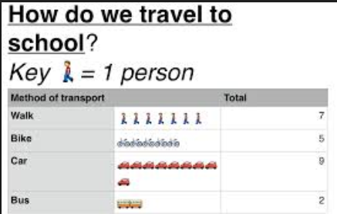
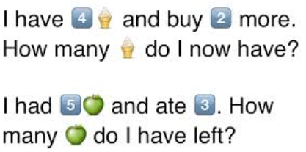
Emojis – Maths
Use the pictures in pictograms (import the graph blank into pages or create one in numbers)
Write some word problems and message them to a friend…

Slide 8
Plickers
Interactive voting tool.
Free account and then you can create lots of interactive quizzes.

Slide 9
Guided Reading - Videos
Use videos from www.literacyshed.com
Pause and ask questions to test the VIPERS criteria for questioning.

Slide 10
Twitter Reviews

